Slide 1
React.JS
Lecture 28
Unit TESTING

Slide 2
Road Map
Presentation Tier of Modern Applications
Page Lifecycle in an AJAX Web Application
Explanation of Testable Areas
Recommended Test Strategy
Integrating DOM and REST Testing
Practical Tips and Tools
Sample Test Cases
Questions

Slide 3
Takeaways
The value of testing an application from multiple architectural tiers
The benefits of combined testing of the User Interface and REST services
Tools, techniques and processes you can use to test the UI and REST services

Slide 4
Web Presentation Tier
Modern Frameworks and the AJAX Page Lifecycle

Slide 5
Possible Web Frameworks
First Generation
Prototype, Mootools, jQuery, ASP.NET AJAX, ExtJS, YUI, GWT
Second Generation
AngularJS 1.0, Knockout, Backbone, Handlebars, Ember, Mustache
Latest Generation
React
Angular 2.0+
Vue

Slide 6
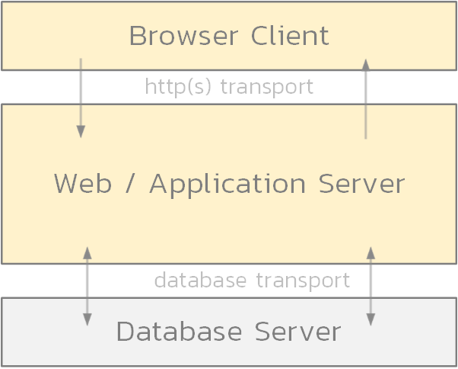
Typical 3-Tier Architecture

Slide 7
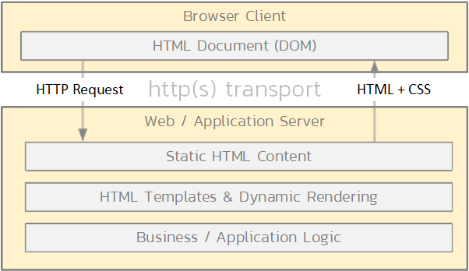
Traditional Web Applications
<html>
<head>…. </head>
<body>
<h1>Products</h1>
<table id=“prd” style=“….”>
…..
</table>
</body>
</html>

Slide 8
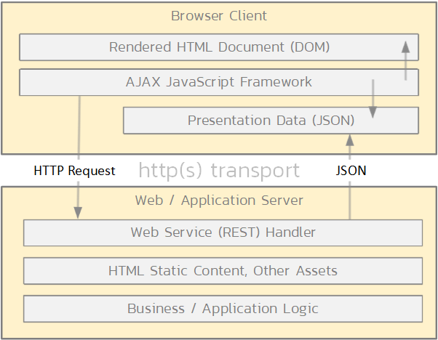
The AJAX Web Application Model
{
products: [
{ id: 1, name: “product 1” },
{ id: 2, name: “product 2” },
{ id: 3, name: “product 3” }
]
}

Slide 9

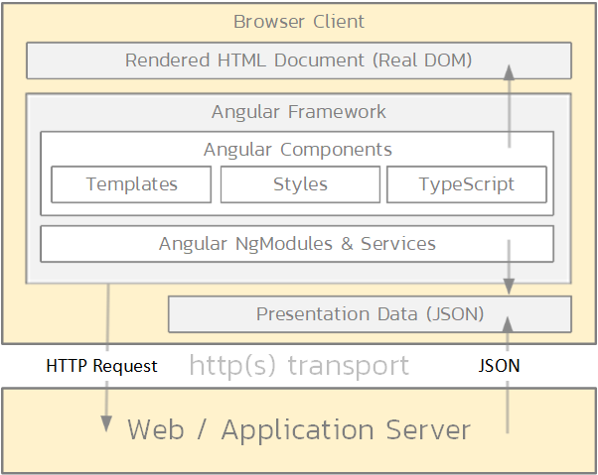
Angular
export class ProductsComponent implements OnInit {
products: Product[];
ngOnInit() {
this.products = this.svc.getProds();
}
}
<h1>Products</h1>
<table>
<tr *ngFor=“let product of products”>
<td>
{{ product.name }}
</td>
</tr>
</table>

Slide 10

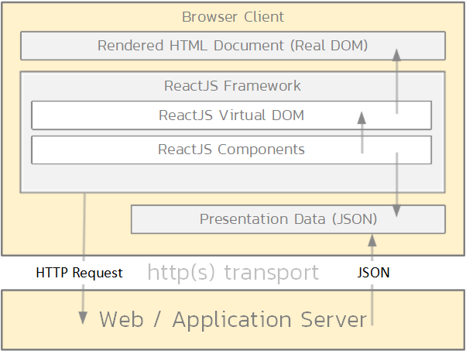
React – Components & Virtual DOM
- html
- head
- body
- h1: “Products”
- table id: “prd” style: “….”
- tr
…
<Table
cancelClick={props.dataCancelEdit}
data={props.data}
deleteClick={props.dataDelete}
editClick={props.dataSetEdit}
editId={props.dataEditingId}
editChange={props.dataChange}
…

Slide 11
Testable Areas

Slide 12
OK So What Can We Test?
JSON Data Returned from REST Calls
Rendered Browser DOM
JS Framework
React
Virtual DOM
Component State
Angular
Components
Services

Slide 13
Test JSON Data Returned
Advantages
Well defined API and data structures – resilient
Unit testing of key modules
Fast to load in test data
Not impacted by browser speed or rendering quirks
Disadvantages
Does not test the end user experience
No testing of any client side business login, validation
Does not validate rendering, templating of JSON

Slide 14
Test Rendered Browser DOM
Advantages
Most realistic testing, validates what the end user experiences
Finds issues due to browser quirks, differences
Can test for usability, performance, responsive design, etc.
Disadvantages
Scenario testing only, cannot test until entire page is rendered
Hard to test specific page components in isolation
Changes in DOM, can potentially break tests – need skill to write resilient tests

Slide 15
Test ReactJS Virtual DOM
Advantages
Can test elements of the rendered page without needing the entire page
Easier to test specific components with varying data sets
Removes browser speed, quirks from tests
Disadvantages
Ignores browser differences
Not full reflection of user experience
Changes to markup in templates will break tests, so not fully resilient
Does not catch DOM-based performance issues

Slide 16
Test ReactJS Component State
Advantages
Easier to test specific components with varying data sets
Tests the client-side business logic (vs. server-side unit tests)
Can test exception cases
Resilient to most UI changes
Disadvantages
Does not test rendering of state/properties into HTML
Tests tied directly to React, limited reusability with other JS frameworks
Does not test end user experience of application

Slide 17
Test Strategy

Slide 18
Sample Test Coverage
Resilience vs. Realism
Browser DOM
Virtual DOM
UI “Component” Tests
REST JSON Tests
Server Side Unit Tests
Testing Breadth

Slide 19
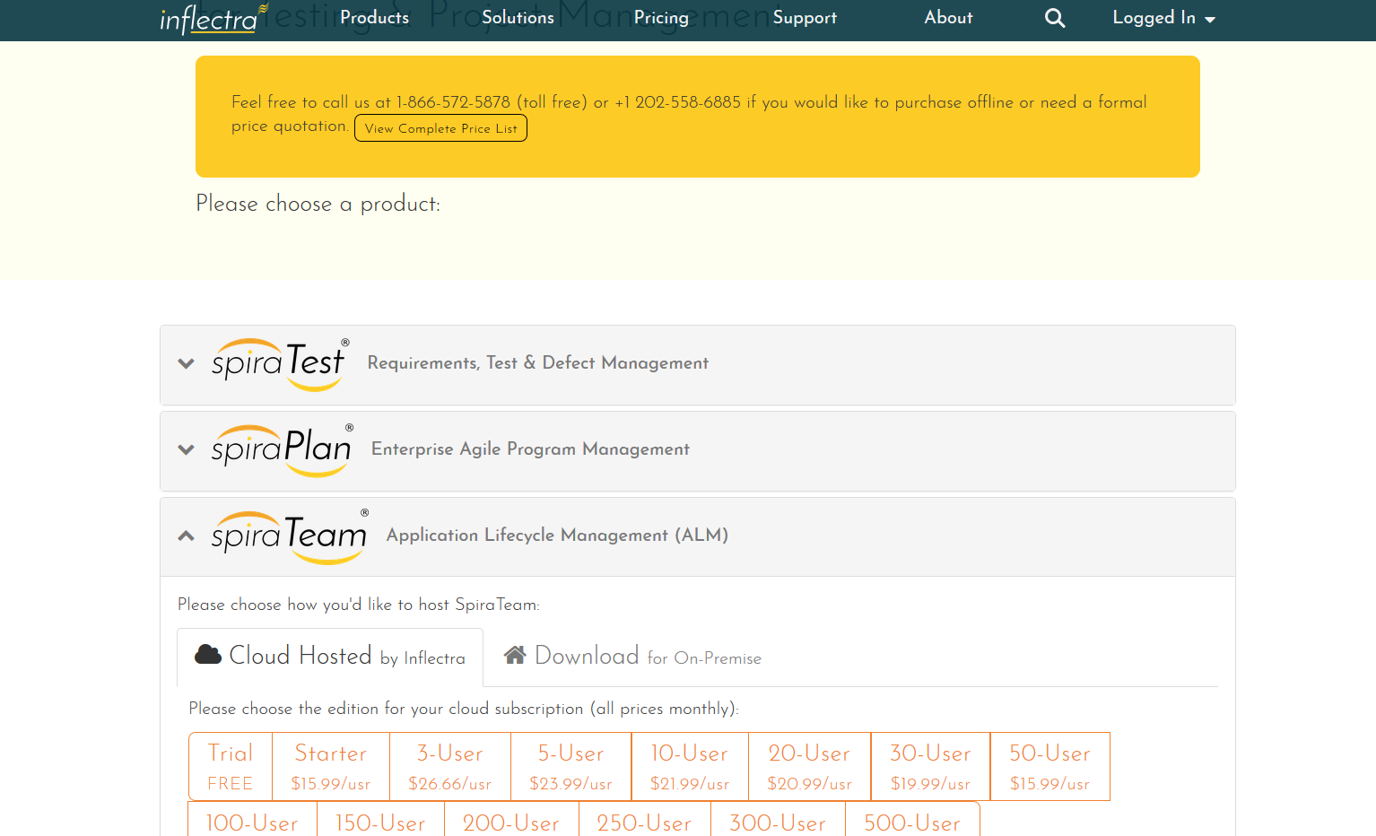
Sample Application – DOM & REST

Slide 20
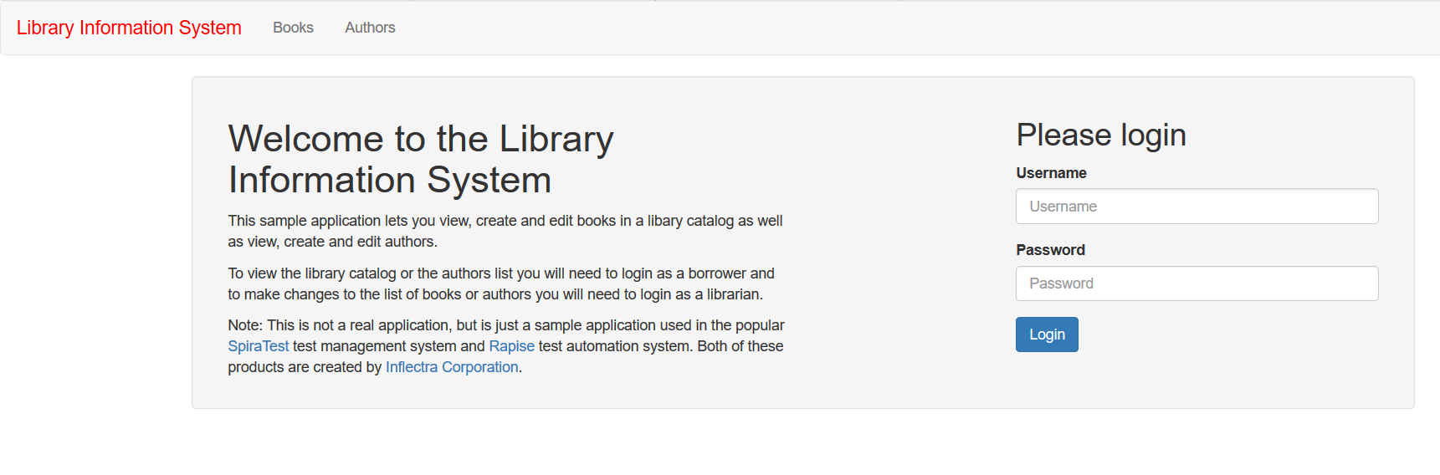
Sample Application – ReactJS
http://www.libraryinformationsystem.org/react-js

Slide 21
Tips and Tools

Slide 22
Top Tools for REST Testing
Postman
SoapUI
Rapise
vREST
Parasoft
Groovy

Slide 23
Top Tools for Browser DOM Testing
Selenium (WebDriver)
Rapise
Ranorex
TestComplete
Tricentis
HP UFT
Squish

Slide 24
JS Framework Specific Tools
React
Testing Component State
TestUtils + Jasmine
TestUtils + JEST
TestUtils + Mocha
Testing Virtual DOM
Enzyme + Mocha
Angular
Testing Services
Jasmine
Mocha
Testing Components
TestBed + Jasmine
TestBed + Mocha

Slide 25
Test categories
Unit tests
Integration tests
End-to-end tests

Slide 26
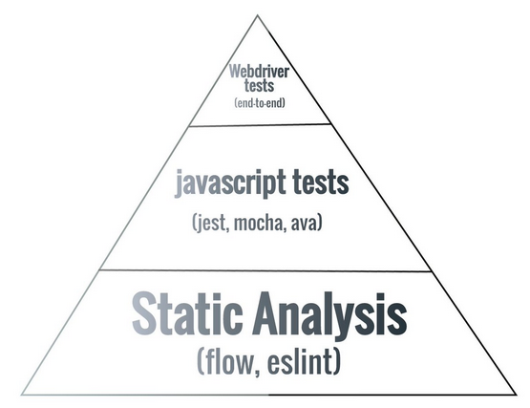
Testing in JS

Slide 27
JEST Testing samples
function sum(a, b) {
return a + b;
}
module.exports = sum;
Testing:
const sum = require('./sum');
test('adds 1 + 2 to equal 3', () => {
expect(sum(1, 2)).toBe(3);
});

Slide 28
Sample Component
// CheckboxWithLabel.js
import React, {useState} from 'react';
const CheckboxWithLabel = ({labelOn, labelOff}) => {
const [isChecked, setIsChecked] = useState(false);
const onChange = () => {
setIsChecked(!isChecked);
};
return (
<label>
<input type="checkbox" checked={isChecked} onChange={onChange} />
{isChecked ? labelOn : labelOff}
</label>
);
};
export default CheckboxWithLabel;

Slide 29
Test Case
// __tests__/CheckboxWithLabel-test.js
import React from 'react';
import {cleanup, fireEvent, render} from '@testing-library/react';
import CheckboxWithLabel from '../CheckboxWithLabel';
// unmount and cleanup DOM after the test is finished.
afterEach(cleanup);
it('CheckboxWithLabel changes the text after click', () => {
const {queryByLabelText, getByLabelText} = render(
<CheckboxWithLabel labelOn="On" labelOff="Off" />,
);
expect(queryByLabelText(/off/i)).toBeTruthy();
fireEvent.click(getByLabelText(/off/i));
expect(queryByLabelText(/on/i)).toBeTruthy();
});

Slide 30

Jasmine
Jasmine is a behavior-driven testing framework for JavaScript programming language.
You can test your code against specifications that you write.
Jasmine tests are primarily two parts: describe and it blocks.
describe('JavaScript addition operator', function () {
it('adds two numbers together', function () {
expect(add(1, 2)).toEqual(3);
});
});
describe is what is called a suite. It is a suite of test specs.
it block is used to test your code block
This is called a specification or spec in short.
we're checking if add() does indeed equal “3“, This is called matcher.
beforeEach() and afterEach() allow you to execute some code you guessed it—before and after each spec.

Slide 31
Jasmine Test Spec
describe("First Test", function () {
var counter;
beforeEach(function () {
counter = 0;
});
it("increments value", function () { // Act (attempt the operation)
counter++;
// Assert (verify the result)
expect(counter).toEqual(1);
})
it("decrements value", function () {
// Act (attempt the operation)
counter--;
// Assert (verify the result)
expect(counter).toEqual(0);
})
});

Slide 32
Simple Test with Arrow Function
describe('Testing math', () => {
it('multiplying should work', () => {
expect(4 * 4).toEqual(16);
});
});

Slide 33
Jasmine Matchers for Evaluating Test Results
expect(x).toEqual(val) : Asserts that x has the same value as val
expect(x).toBe(obj): Asserts that x and obj are the same object
expect(x).toMatch(regexp): Asserts that x matches the specified regular expression
expect(x).toBeDefined(): Asserts that x has been defined
expect(x).toBeUndefined(): Asserts that x has not been defined
expect(x).toBeNull(): Asserts that x is null
expect(x).toBeTruthy(): Asserts that x is true or evaluates to true
expect(x).toBeFalsy(): Asserts that x is false or evaluates to false
expect(x).toContain(y): Asserts that x is a string that contains y
expect(x).toBeGreaterThan(y): Asserts that x is greater than y

Slide 34
Summary
Modern web applications are complex and hard to test
You need to test each of the different tiers
Some tiers are easier to test than others
You need to carefully plan your testing to have the best coverage of the tiers with least effort

Slide 35
Questions?

